Slide 1
Session 5: Group Dynamics, Relations and Teams (Chapters 7 & 8)
Shoonchul Shin
Assistant Professor
shoonchuls@business.aau.dk
1.12, Niels Jernes Vej 08A
10:15-12:00
February 14, 2023

Slide 2

Carolina D. Happe (age 50) - CFO at General Electric since March 2020
Born and raised in Stockholm
1992-1996, Master of Science in Business and Economics, Uppsala U.
No MBA
1996, EF Education First (an international education company)
2002, ASSA ABLOY, a Swedish conglomerate company
2011, CFO of Trelleborg, a Swedish engineering company
2012, CFO of ASSA ABLOY
2019, CFO of A.P. Moller-Maersk, a Danish shipping company
3/2020 - present, CFO of General Electric
First outsider and non-American CFO at GE

Slide 3
Chapter 7. Group Dynamics

Slide 4
Subject matter of group dynamics
What is a group?
Definition; types of groups in workplace
How groups function?
Organizational and individual functions
How groups are structured?
Roles, norms, size (composition) and group cohesiveness
How groups form and develop?
Bruce W. Tuckman’s five-stage theory of group development
What are the threats to group effectiveness?
The Asch effect, Social loafing, groupthink
Social network perspective
Structural hole in communication networks
Overarching question:
Why and how are some groups more effective than others?

Slide 5
What is group dynamics (or group processes)
Group dynamics:
A social and psychological process wherein an actor influences other actors in their attitudes, behaviors and opinions.
Group dynamics gives rise to a set of norms, identities, roles, goals and relations that define a particular group.
Premise:
The whole is not equal to the sum of its parts.
A group has its own attitudinal and behavioral properties that cannot be reduced to the individual proprieties of people who make up the group.
The behaviors, attitudes and opinions of each group member are influenced by the structural properties of the group itself.
Therefore, we need to look at the structural properties of the group itself to understand the behavior and performance of each group member.

Slide 6
What is a group?
Four sociological criteria for a group
A group refers to two or more freely interacting individuals who share collective norms and goals and have a common identity. (p.225)
Goals: Reason for group formation
Norms: Boundaries of acceptable behavior
Identity: Common sense of belonging to the group
Identity
Norms
2 + individuals
Goals

Slide 7
What is a group? (continued)
Organizations should be viewed as a collection of groups rather than individuals. (Rensis Likert 1961)
Types of groups
Formal group
Informal group
Relatively permanent
Command group or functional group
Finance department (CFO)
Sales department
Board committees
Audit committee
Finance committee
Compensation committee
Sustainability committee
Friendship group
Common characteristics, such as age, gender, school of origin, political beliefs, religious values, or ethnic backgrounds
Relatively temporary
Task group
Task force team
Interest group
Common interests

Slide 8
How groups function?
Groups fulfill organizational and individual functions (p.227)
Organizational functions
Accomplish complex, interdependent tasks that are beyond the capabilities of individuals
Generate new or creative ideas and solutions
Co-ordinate interdepartmental efforts
Provide a problem-solving mechanism for complex problems requiring varied information and assessments
Implement complex decisions
Socialize and train newcomers
Individual functions
Satisfy the individual’s need for affiliation
Develop, enhance and confirm the individual’s self-esteem and sense of identity
Give individual an opportunity to test and share their perceptions of social reality
Reduce the individual’s anxieties, and feelings of insecurity and powerlessness
Provide a problem-solving mechanism for personal and interpersonal problems

Slide 9
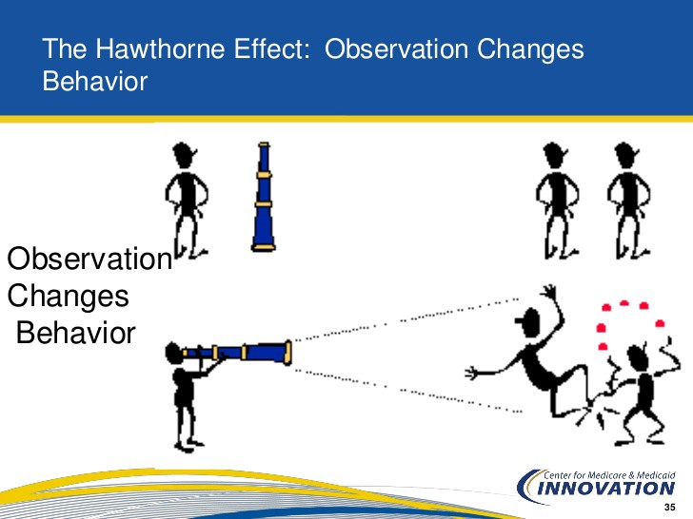
How groups function? (continued)
Example: The Hawthorne Effect
The Hawthorn experiments (Elton Mayo) at the Hawthorne plant of Western Electric Company in Illinois during the late 1920s and early 1930s.
Key finding:
Workers tend to work harder simply because they know that they are being observed.
Implication for group dynamics:
Worker’s job satisfaction and performance can increase through their participation in decisions rather than through short-term incentives.

Slide 10
How groups are structured?
Structural Characteristics of a Group
Roles
Norms
Size
Cohesiveness

Slide 11
(1) Roles
A group role:
An expected behavior pattern that is assigned to a particular position within a group.
Roles are specific to a position (e.g., leadership roles, production roles)
Roles involve behavioral expectations for people in a position.
Two types of roles in a work group:
Task (goal) oriented roles: People in task roles focus on task-related activities aimed at accomplishing group performance goals.
Maintenance (relationship) oriented roles: People in maintenance roles focus on activities aimed to foster supportive interpersonal relationships.
E.g., building group cohesiveness; preserving group harmony; looking after employee welfare.

Slide 12
(1) Roles (continued)
Role Episode Model
Role Episode Model explains how a particular role is learned and acted upon.
The model describes the ongoing interaction between a Role Sender (manager) and a Focal Person (one who takes the role).
“In an ideal setting”, a Role Episode goes fairly straightforward,
Stage 1: Group expectations for a Focal Person
- The Role Sender sets expectations about what a Focal Person should be doing in a position.
Stage 2: Communication about group expectations
- The Role Sender communicates these expectations to the Focal Person.
Stage 3: Perceived expectations about role
- The Role Sender becomes aware of the expected role.
Stage 4: Actual role behavior
- The Role Sender acts upon the expected role.

Slide 13
(1) Roles (continued)
Yet in reality,
The Role Episode is not that simple.
Role receivers often have difficulties in meeting the expectations of Role senders.
The difficulty has three main sources:
Role Overload: Too high demand or workload
Role Conflict: Conflicting demands from various groups, such as work group and family
Role ambiguity: Unclear job description
When Role Overload, Conflict or Ambiguity is experienced, job satisfaction, motivation and performance declines.

Slide 14

(1) Roles (continued)
Example of role conflict
Arlie Hochschild (1992) The Second Shift: Working Families and the Revolution at Home
Historical background: An enormous number of women and mother joined the workforce in the U.S. in the 1970s and 1980s.
Research question: How U.S. families were coping with this revolutionary change?
Research method: Interviewed 50 American couples
Key findings:
A Double Day: Women came home from a full day of paid work to ‘another round of unpaid household work and childcare.’
The Second Shift refers to the “another round” of work at home.
A Role Episode does not go straightforward especially for women due to conflicting demands from work and family.

Slide 15
(2) Group norms
Norms
“shared attitudes, opinions, feelings or actions that guide social behavior”. (p.234)
Characteristics of norms
Norms are manifested themselves in the acceptable standards of behavior within a group that are shared by the members of the group.
Norms define the boundaries of acceptable (right) and unacceptable (wrong) behavior, so that:
they regulate and regularize group members’ behavior.
they regulate interaction between group members.

Slide 16
(3) Group size
Does group size affect employee behavior and performance?
Yes, group size matters.
Large groups
Ability to process a large amount of information.
high problem-solving and decision-making capabilities.
Large groups are appropriate for high-quality decisions.
Small groups
high cohesiveness, high satisfaction of members, fast decision making.
Small groups are appropriate when problem-solving tasks are relatively easy.

Slide 17
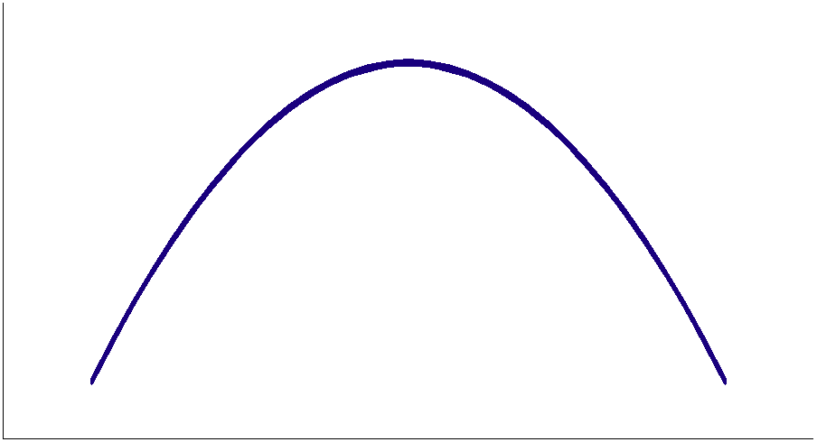
(3) Group size (continued)
Then, what is the optimal size for maximizing employee and group performance?
Group size can affect group members’ behavioral outcomes.
(1) Group interaction; (2) cohesiveness; (3) satisfaction; (4) absenteeism; (5) turnover; (6) social loafing
Such effects generate an inverted U-shaped relationship between group size and performance.
Generally speaking, the good size is between 6 and 12.
Yet “there is no hard-and-fast rule about group size” (p.238).
Behavioral outcomes
Small
group
Large
group
Interaction
Cohesiveness
Satisfaction
Absenteeism
Turnover
Social loafing
High
High
High
Low
Low
Low
Low
Low
Low
High
High
High
6 to 12?
Performance
Group size

Slide 18
(3) Group size (continued)
FYI: Haleblian & Finkelstein (1993) “Top management team (TMT) size, CEO dominance, and firm performance: The moderating roles of environmental turbulence and discretion.” Academy of Management Journal 36(4): 844-863
Question: How can TMT size affect firm performance?
Variables:
Independent variable: TMT size
The number of executive officers who are also board members (e.g., CEO, COO, CFO).
Dependent variable: Firm performance
ROA (return on assets), ROS (return on sales) and ROE (return on equity).
Findings:
In a turbulent environment (computer industry), the larger the TMT size, the higher the firm performance.
In a stable environment (natural gas distribution industry), TMT size does not matter to firm performance.
Conclusion: The appropriate group size is contingent on the characteristics of industrial domains in which an organization is situated.

Slide 19
(4) Group cohesiveness
Group cohesiveness
The degree to which a group’s members are attracted or motivated by each other.
The group can be seen as highly cohesive when group members respect each other and when they are fully committed to the decision made by the decision.
Group cohesiveness and effectiveness (performance)
Group size: When group expand at higher levels, the problems of interaction and coordination become acute, thereby leading to lowered performance.
Group diversity:
Diversity regarding tasks and skills:
Groups can benefit when each member has distinct skills that can interact to improve group cohesiveness and effectiveness (innovation and creative solutions).
Diversity regarding social relations:
Diversity can be harmful when it is based on demographic characteristics, such as ethnicity, gender or age.

Slide 20
How do groups develop?
Why do groups form?
Groups fulfill organizational and individual functions.
Individuals are motivated to become a member of a group because of their needs for belongingness, identity, feeling of insecurity, or work information.
How do groups develop?
Bruce W. Tuckman, an American Educational Psychologist
Five-stage theory of group development
This model was initially proposed in 1965; modified in 1977.

Slide 21
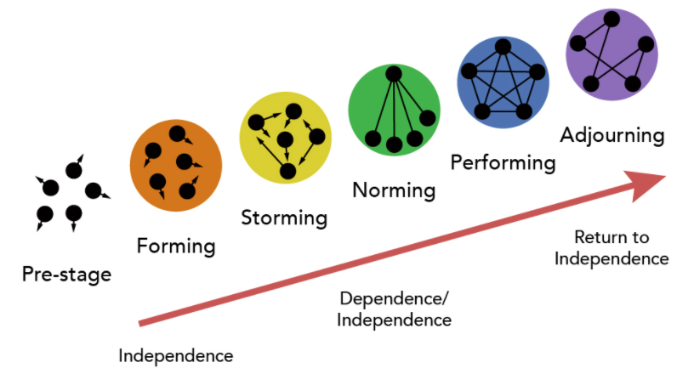
How do groups develop? (continued)
Key ideas:
Groups undergo identifiable stages of development as group members seek for group effectiveness and productivity.
Groups generally proceed through a sequence in their evolution, and that sequence is called the five-stage model.
Each stage involves specific issues or problems that group members should resolve to proceed on to the next stage.
Group effectiveness is maximum at the Performing stage.
Bruce W. Tuckman:
Five-Stage Theory of Group Development

Slide 22
How do groups develop? (continued)
Tuckman’s Five-Stage Theory of Group Development
Stage
Forming
Storming
Norming
Performing
Adjourning
Issues to be resolved
How do I fit in?
Why are we here?
What’s my role here?
Why are we fight over who is in charge and who does what?
What do the others expect me to do?
Can we agree on roles and work as a team?
How can I best perform my role?
Can we do the job properly?
What’s next?
Can we help members transition out?

Slide 23
Further question regarding group dynamics
So far,
What is a group?
How groups function?
How groups are structured?
How groups develop?
Next Question:
5) Is group cohesiveness always good?
What are the threats to group effectiveness?

Slide 24
Threats to group effectiveness
Social loafing
The tendency of people to make less effort when they are part of a group
People will likely engage in social loafing:
if they are less motivated by a task,
if they feel less personally accountable for a task,
if they are working in a large group, or
if they expect others to slack off.
Groupthink (Irving L. Janis, an American social psychologist)
The tendency of people to strive for consensus or unanimity when the group is tightly knit and cohesive.
“The result is that policy- and decision-making groups can become so cohesive that strong-willed executives are able to gain unanimous support for poor decisions (see Figure 7.6).” (p.240)

Slide 25
Threats to group effectiveness (continued)
The Asch effect (Solomon Asch, an American social psychologist)
The tendency of people to conform to a majority opinion or norm, even when they perceive the opinion wrong or bad.
People conform,
because they want to fit in the group (normative influence) and
because they believe the group is better informed than they are (informational influence).
Would you fall for that – Elevator experiment on the Asch effect
https://www.youtube.com/watch?v=dDAbdMv14Is

Slide 26

Social network analysis (SNA)
Social network is defined as a set of social actors (individuals, groups or organizations) and the (dyadic or triadic) relations between actors.
Social network analysis (SNA) is a research method for mapping and measuring the relationships between social actors.
Key idea: Social networks affects people’s behavior and performance by shaping the way information flows.
E.g., when college students are well connected to peer group networks, they are more likely to obtain the crucial information about a new job opportunity.
Social network researchers seek to understand what are the causes and consequences of social relations.
E.g., the effect of college student networks (IV) on job market outcomes (DV).
E.g., the effect of engineer networks on product innovation
Ronald S. Burt
Chicago Booth Business School

Slide 27
Social network analysis (continued)
Example: Communication network in a group or organization
Node
Nodes: People in the network
Edges: Direct connections between people
Degree Centrality:
Number of Edges a node has (e.g., the degree centrality of the node F is 4)
The higher the degree centrality, the greater the amount of information needed for a task.
Star: A person who has the largest number of relations (the highest degree centrality).
Isolate: A person who has no connections
A
C
B
D
Edge
G
E
Isolate
Star
F
I
H
J

Slide 28
Social network analysis (continued)
“Structural hole” (the term coined by Ronald Burt)
A structural hole exists in social networks when there is a lack of direct tie between two or more sub-groups (Ronald Burt 1992).
Bridge builder: A person who is positioned in a structural hole (i.e., the node D).
Social networks are most beneficial for people in a structural hole.
People in a structural hold have access to information that flows from multiple sub-groups.
Node
A
C
B
Structural hole
(Ronald Burt)
D
Edge
G
E
Isolate
Star
F
I
H
Redundant information is circulated within a sub-group
J

Slide 29
Chapter 8. Teams and Teamwork

Slide 30
What is a team?
Group: “Two or more freely interacting individuals who share collective norms and goals and have a common identity.” (p.225)
Types of groups
Formal group
Informal group
Relatively permanent
Command group or functional group
Finance department (CFO)
Sales department
Board committees
Audit committee
Finance committee
Compensation committee
Sustainability committee
Friendship group
Common characteristics, such as age, gender, school of origin, political beliefs, religious values, or ethnic backgrounds
Relatively temporary
Task group
Task force team
Interest group
Common interests

Slide 31
What is a team? (continued)
Key elements of a team:
Common commitment and purpose
Complementary skills
Commitment to how the work gets done
Mutual accountability
Team:
“A small number of people with complementary skills who are committed to a common purpose, performance goals and approach for which they hold themselves mutually accountable (Katzenbach and Smith 1993:45).” (p.255)

Slide 32
What is a team? (continued)
Group becomes team
Five-Stage Theory of Group Development
(Bruce W. Tuckman)

Slide 33
What is a team? (continued)
GROUP
Focused leader
Chief financial officer, Chief marketing officer etc.
Individual accountability
Purpose aligned with organizational goal
Financial works, marketing works
Contribution to the organization
ROA (return on asset), ROS (return on sales), ROI (return on investment)
TEAM
Shared leadership
Mutual accountability
Specific project
R&D, new products or services
Devising policies about diversity
Quality of project outcomes

Slide 34
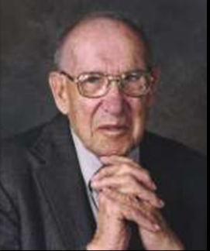

Team-based approach: Towards a flatter, flexible and responsive organization
Peter Drucker (1988):
“The Coming of the New Organization”, Harvard Business Review, January-February: 45-53
“Tomorrow’s organizations will be flatter, information based and organized around teams.” (p.254)
J. Richard Hackman (2002):
“Leading Teams: Setting the Stage for Great Performances”, Boston: Harvard Business School Press.
Effective team leaders are those who have the subtle skills to get a team established on a good trajectory, and then to make small adjustments among the ways to help members succeed.
Peter Drucker
(1909-2005)
Richard Hackman
(1940-2013)

Slide 35
FYI: Evolution of an Organization’s Control System
Chester Barnard (former AT&T executive)
“A key defining element of any organization was the necessity of individuals to subordinate, to an extent, their own desires to the collective will of the organization”
(1968, The Functions of the Executive).
Feudalism
Market-driven capitalism
Control of arable land
Direct
control
of labor
Technical control
of labor
Bureaucratic control
of labor
(Modern organization)
Post-bureaucratic control of labor
Early capitalism
Family-owned company
Late 1800s and early 1900s
Assembly line
“Fordism”
Taylorism (1911)
“Scientific Management”
Circa 1920s through 1970s
“Red tape”
“Hawthorne effect”
“Theory X and Y”
“Motivation theory”
“Group dynamics”
1980s to present
Teams and teamworks (Ch 8)
Originated in Japanese companies (e.g., Toyota)

Slide 36
What makes teams effective?
“Richard Hackman’s Team Effectiveness Model” (2002)
Five requirements for an effective team: The team has to,
be a real team
Teams work better when they have a boundary of membership, interdependence among members and stability of membership over time.
have a compelling direction
Teams work better that they have a clear goal, both challenging and consequential.
have an enabling structure
Teams work better that they have a clear task, membership composition and core norms of conduct.
have a supportive context
Teams work better that they offer rewards for performance, skills and information.
have expert coaching
Teams work better that they help members to develop skills.
Good team leaders can,
ensure that the team’s basic performance conditions are sound,
help team members take the greatest possible advantage of their favorable circumstances.

Slide 37
What makes teams effective? (continued)
“An Ecological Model of Work Team Effectiveness” (Figure 8.4)
Organizational context
Strategy
Structure
Technology
Culture
Reward system
Administrative support/training
Team effectiveness criteria
1. Performance
Team output meets customers’ expectations
2. Team viability
Members satisfied with team experience
Members willing to continue contributing to team effort
Work teams
Member composition
Interpersonal dynamics
Purpose
Resources
Co-ordination with other work units

Slide 38
What makes teams effective? (continued)
Note:
Trust refers to “reciprocal faith in others’ intentions and behavior” (p.270)
Co-operation occurs when team members’ efforts are integrated to achieve a collective goal. (p.269)
Cohesiveness is a “process whereby a sense of we-ness emerges to transcend individual differences and motives.
“Why Work Teams Fail” (Figure 8.5)
Mistakes typically made by management
Lack of trust
Vague or conflicting team assignments
Inadequate team skills training
Poor staffing of teams
Problems typically experienced by team members
Lack of trust
Conflict over differences in personal work styles
Poor interpersonal skills
Poor interpersonal chemistry
Unrealistic expectations
resulting in frustration
De-motivation
Reduced cooperation and cohesiveness among team members

Slide 39
Does team composition matter to improve team effectiveness?
Example: Study of tank-crew team effectiveness at Tel Aviv University (p.256)
Question: How does team composition (staffing) affect team effectiveness in Israeli tank crew members?
Experimental design:
Researchers formed 208 three-man tank crews from a pool of 624.
Each soldier’s ability to operate tanks was coded as “High” or “Low”.
Then, all possible combinations of High- and Low-ability crew were studied (i.e., H-H-H; H-H-L; H-L-L; L-L-L).
Findings:
Not surprisingly, the H-H-H team performed the best, and the L-L-L team the worst.
But they also found an interaction effect.
The H-H-H team performed far above expected levels.
By contrast, the L-L-L team far below expected levels.
Implication:
Team membership composition (staffing) matters, as each member’s behavior and performance is influenced by other members.

Slide 40
Does team composition matter to improve team effectiveness? (continued)
“A Contingency Model for Staffing Work Teams: Effective Use of Available Talent” (Figure 8.2)
Organizational objective(s)
Spread talent around
Improve performance of all work groups
Train and develop new talent
Appropriate for high-volume production teams
Staffing decision
Maximize performance of best group(s)
Appropriate for R&D teams
Concentrate talent
Implication: Managers have to take organizational objectives into account when making staffing decisions.

Slide 41
Typology of teams
4 General Types of Work Teams and Their Outputs (Table 8.3)
Typology
Advice teams
Quality circles
Committees
Production teams
Assembly teams
Maintenance crews
Project teams
R&D teams
Task force
Action teams
Surgery teams
Athlete teams
Objective
Provide information needed for decision making
Perform day-to-day operations
Provide creative solutions for urgent organizational problems
Exhibiting peak performance on demand
Typical outputs
Suggestions
Recommendations
Food, chemicals
Customer service
Plans, designs
Reports, findings
Concerts
Surgical operations

